Slide 1
Artwork by Ellie Prakken

Slide 2
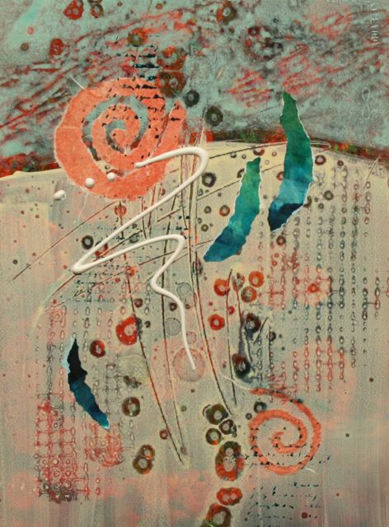
Experimenting

Slide 3
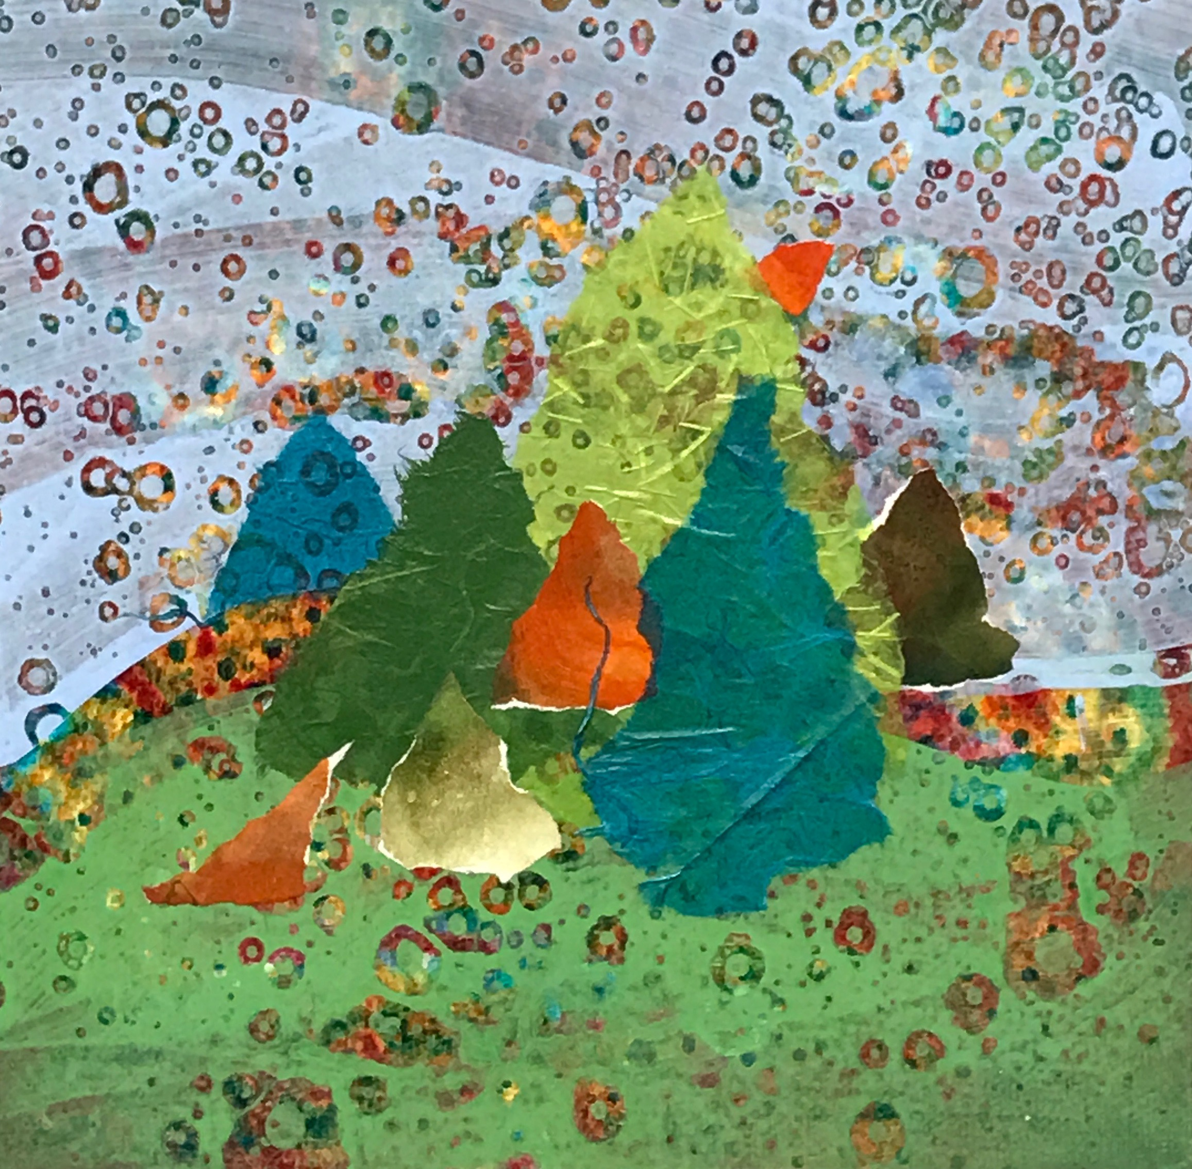
Forest Fantasy

Slide 4
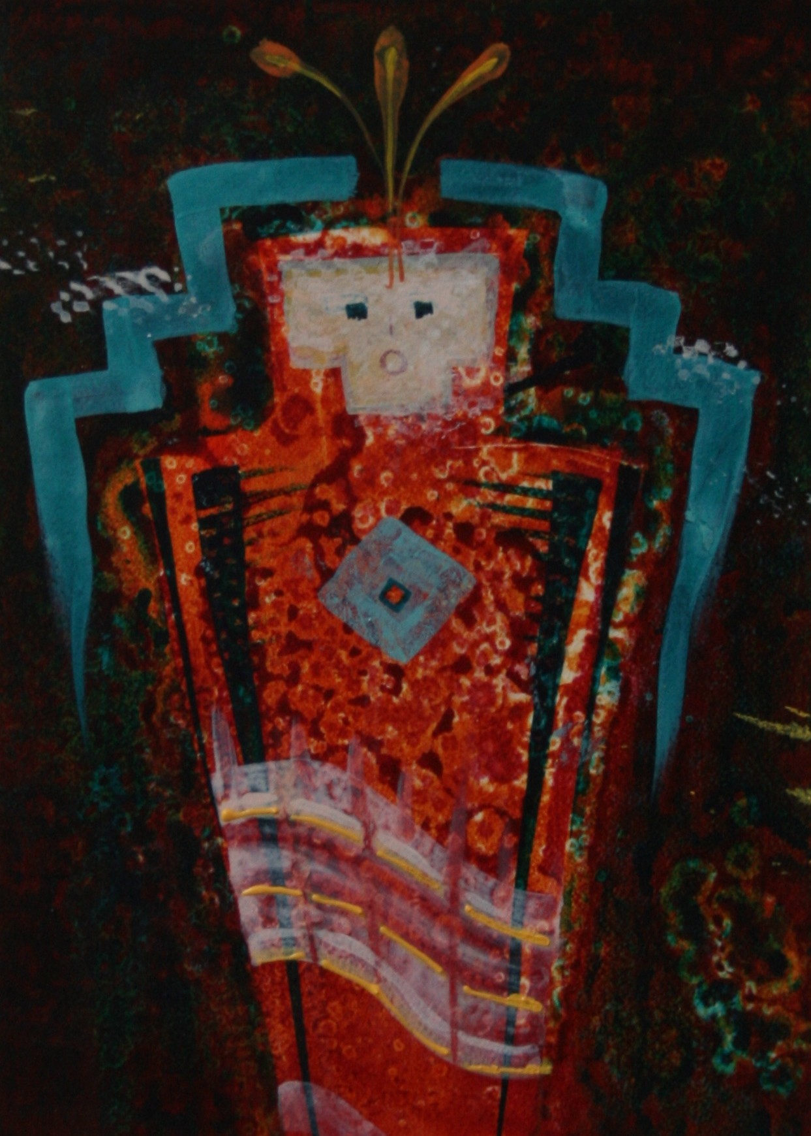
Kachina I

Slide 5
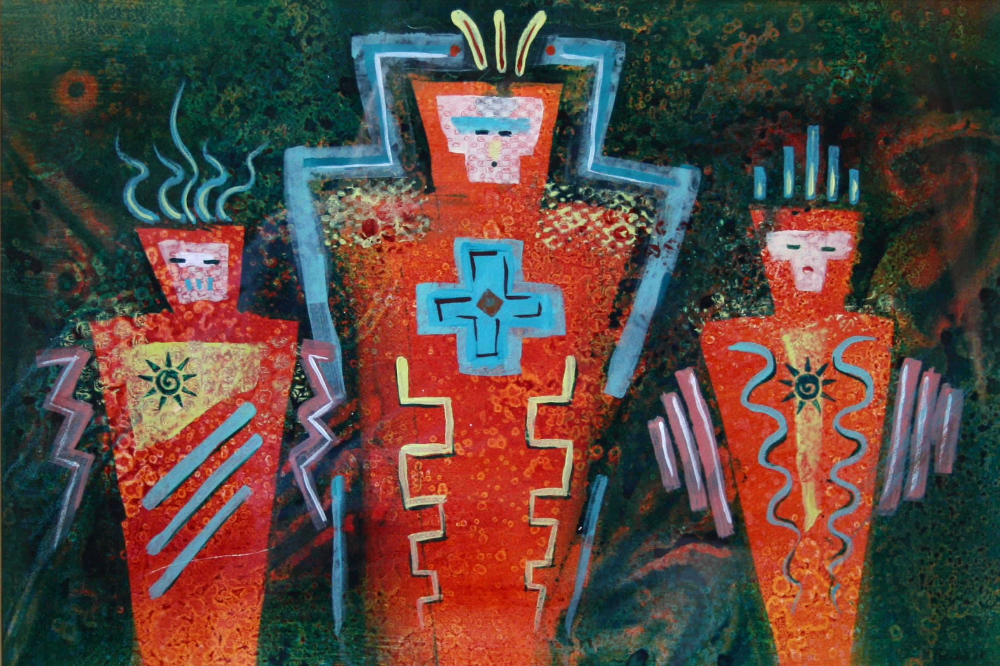
Tribal Trilogy

Slide 6
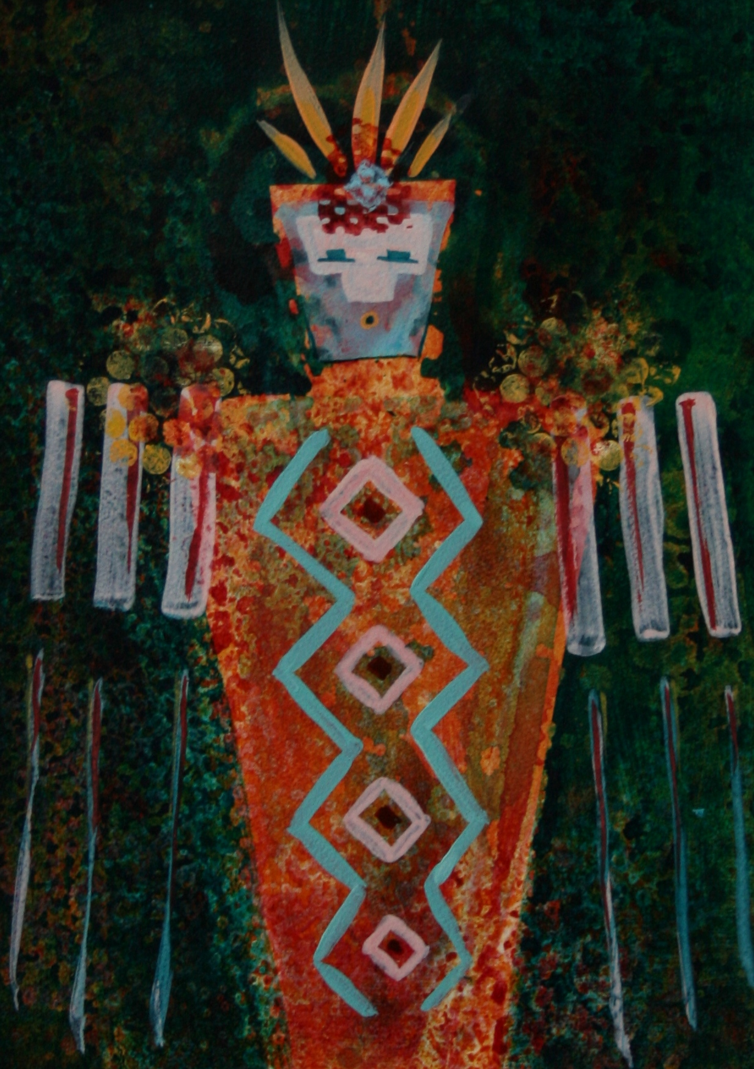
Kachina II

Slide 7
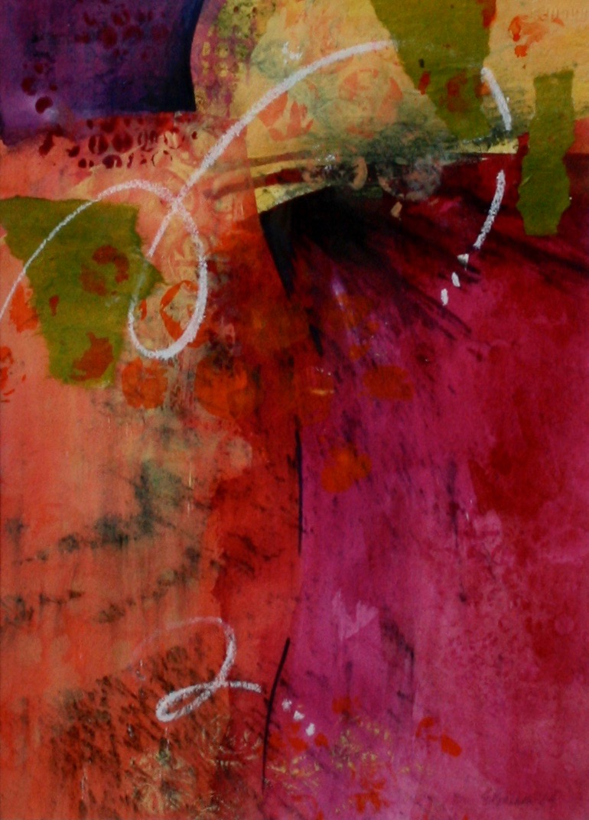
Fanfare

